Slide 1
Git Integration Options for Jira https://github.com/bobk/jirapresentations
meetup.com - Princeton Lean Coffee Agile Meetup
Lightning Talk – Mar 25, 2020 (add link here)
Bob Kozlowski - http://www.robertkozlowski.com
Versatile experienced Agile/SDLC/Jira/Windows/CI/CD DevOps engineer
25 years financial services IT experience - CSM, Microsoft Azure, Windows, ITIL certs
available Apr 2020 for short-term/part-time contracting roles

Slide 2
What is “Git Integration for Jira”?
JOB 1
Functionality to automatically associate Git commits with Jira issues, so that everyone knows what code was delivered to meet which requirement
A process runs on the Jira side, the Git side or a third location to scan for commits + issues that are related and record them, usually in the Jira issues themselves
EXTRA CREDIT
make Git additional commit information and statistics available in Jira, including extending JQL to support key Git parameters
perform certain basic Git commands from Jira
perform certain basic Jira actions from Git (via commit messages)

Slide 3
What Are The Benefits? Why Have This? Who Is The Customer?
Anyone who needs to know what code was written for Jira issues and review it in a familiar environment – who coded this feature, how “big” was the change (developers)
Anyone who wants to (lightly) track progress against features (product managers)
Anyone who needs to support the code in production, or be able to answer questions/resolve problems related to new functionality or security (operational support, helpdesk, security engineers/pen testers)
Anyone who needs to pull statistics on code relative to Jira issues such as complexity vs commits, commit rollbacks, bugs against features (scrum masters, dev team leads)
Anyone who wants to automate certain Jira functions during code dev cycle (release managers)
Anyone doing CI/CD who wants to build specific branches containing specific commits (release managers, DevOps engineers)

Slide 4
Product Landscape
(using public GitHub specifically as an example - some products do not support GitHub Enterprise, GitLab or other third-party Git incarnations)
Atlassian’s built-in integration (cloud, server)
GitHub’s built-in integration (cloud)*
Third-party Jira plug-ins (cloud, server)
e.g., Git Integration for Jira plug-in from BigBrassBand
Home-grown scripts
use Jira and GitHub REST APIs
e.g., jiragithub sync script (yes, it’s available on GitHub)
* GitHub has “issue” functionality, but no strong workflow model, and their integration marketplace is not yet as mature as Atlassian’s

Slide 5
Pros/Cons: Plug-In vs Script
Product | Pros | Cons
Plug-In | typically better integrated into the Jira UI more functionality repo indexing handled on Jira server side can use Jira permissions to control actions may be easier to support different Git incarnations vendor support | license cost stability concerns? admin friction/elevated rights/migrations/testing can change Jira settings + add custom fields
Script | no license cost (!= free) stability not a big concern no admin friction you can understand, change and extend what it does if you have the source | no paid support no permissions model Less well-integrated into Jira UI need to rack up and run yourself
(Above pros/cons are general notes and are not specific to or descriptive of any given product.)

Slide 6
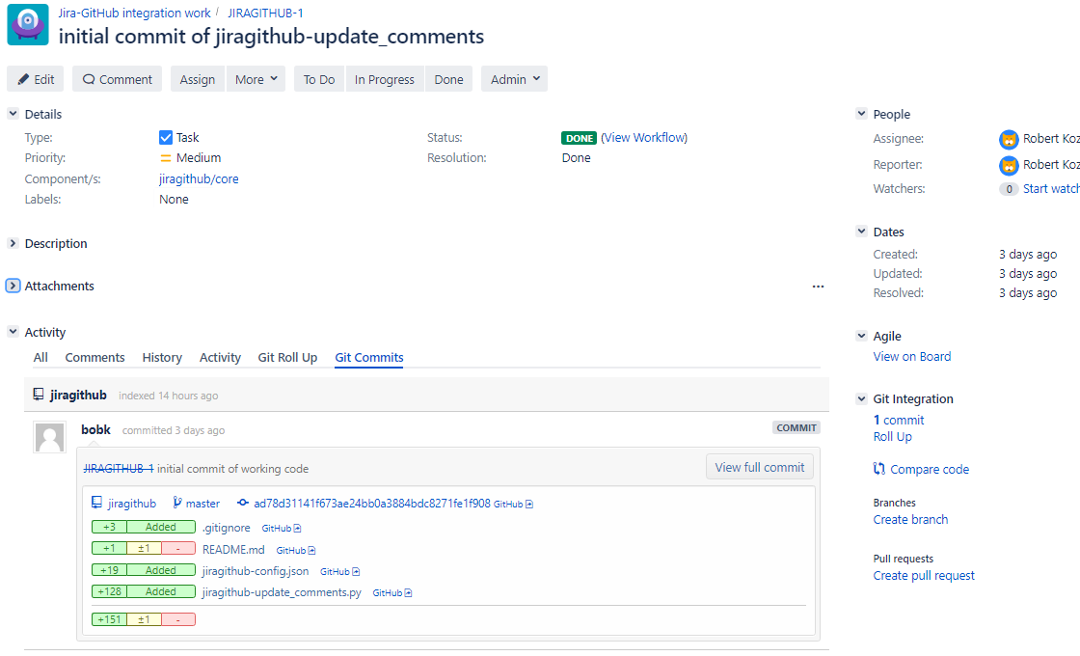
Git Integration for Jira from BigBrassBand Screen Shots

Slide 7
Git Integration for Jira from BigBrassBand Features
View Git commit information in Jira
“Smart Commits” – add comments, transition issues etc. via commit messages
Manually associate commits when needed
Direct links to branches and commits
Git-specific JQL
Create branches from Jira
Create pull requests from Jira
Permissions model to control source code access from Jira
My recommended option, if you choose to go the plug-in route

Slide 8
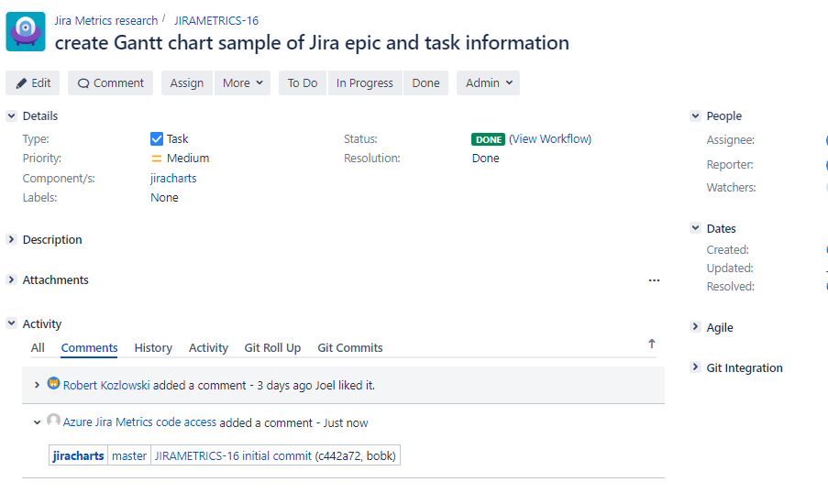
http://github.com/bobk/jiragithub Screen Shots

Slide 9
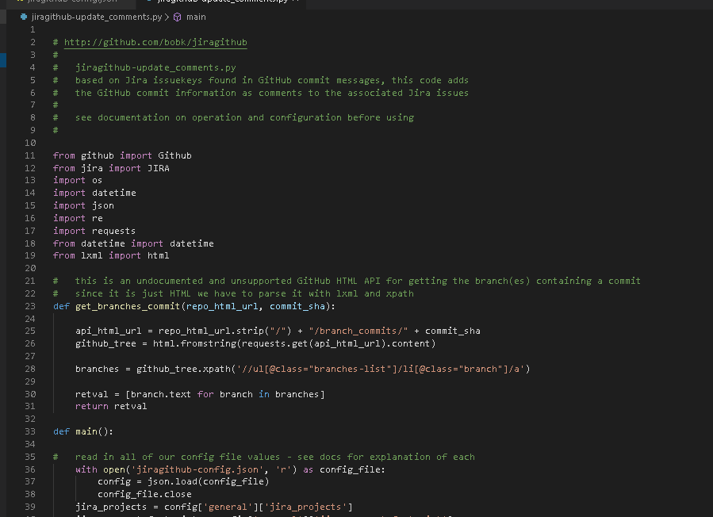
http://github.com/bobk/jiragithub Screen Shots

Slide 10
Questions/Feedback?
Thank You!
Robert Kozlowski
http://www.robertkozlowski.com

Slide 11
Next Time?
Jira Issue Collectors and what to use them for
Python as poor-man’s Jira command-line (via jira-python/jirashell interpreter)
Review of good Jira tech books

